Slide 1
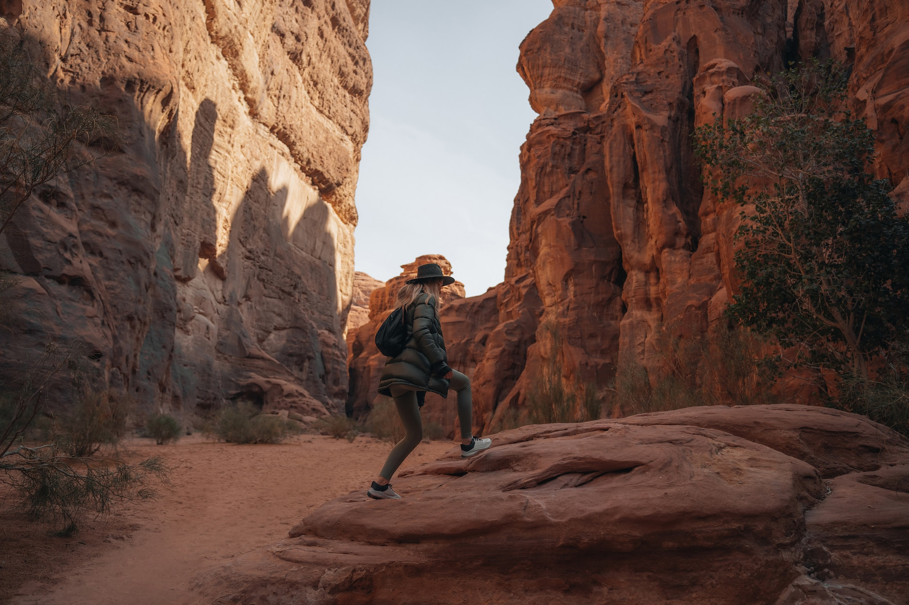
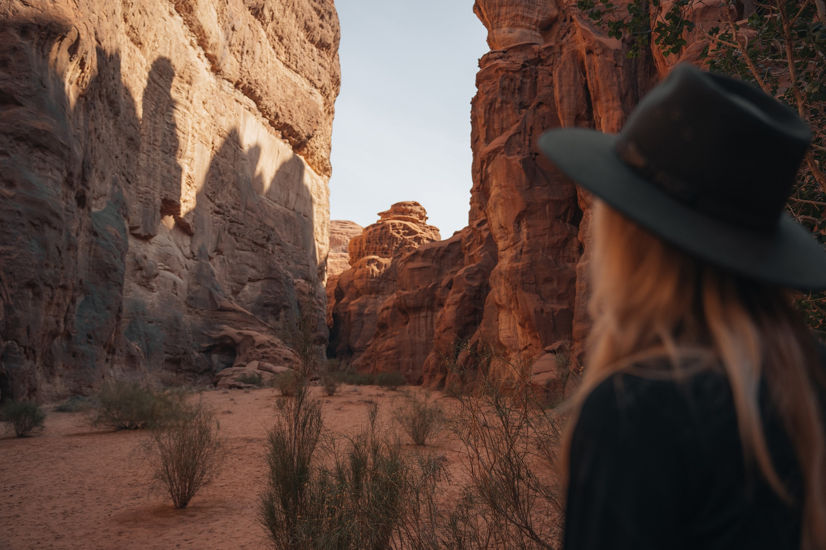
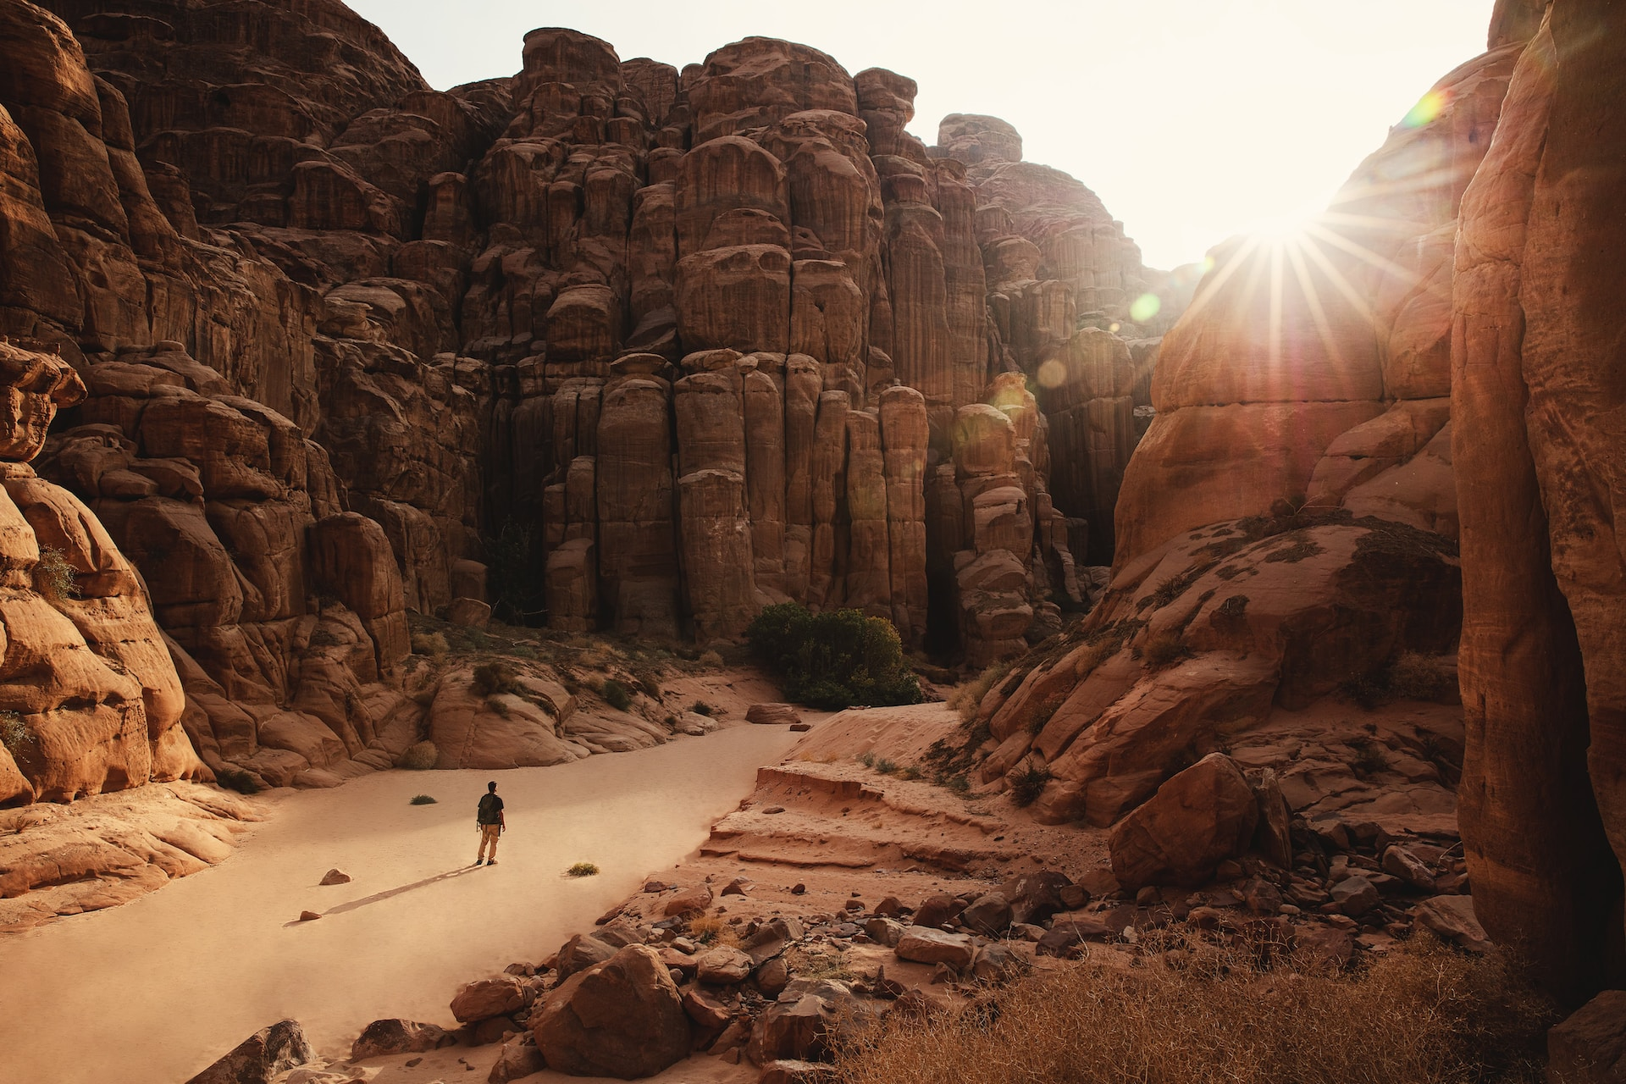
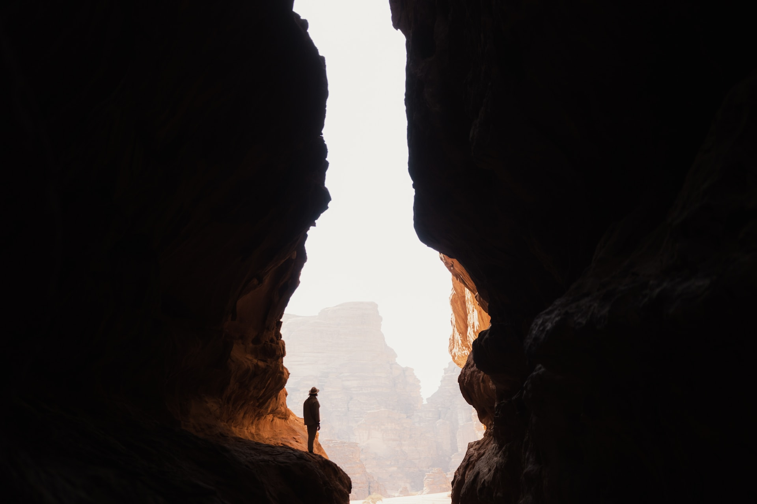
Hisma Desert

Slide 2

Hisma Desert

Slide 3

Hisma Desert

Slide 4
Hisma Desert

Slide 5
Hisma Desert

